Slide 1
Linear Algebra
Lecture 31

Slide 2
Linear Algebra
Lecture 31

Slide 3
Eigenvalues and
Eigenvectors

Slide 4
Eigenvectors
and Linear
Transformations

Slide 5
To understand the matrix factorization A=PDP⁻¹ as a statement about linear transformation

Slide 6
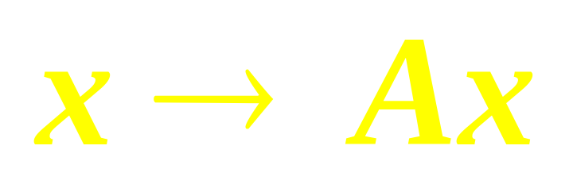
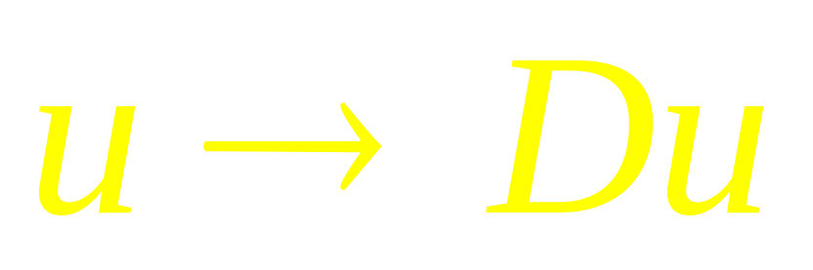
Transformation
is the same
as mapping

Slide 7
The Matrix of Linear
Transformation
Let V be an n-dim Vector space, W an m-dim space, and T be a LT from V to W. To associate a matrix with T we chose bases B and C.

Slide 8
The Matrix of Linear
Transformation
Given any x in V, the coordinate vector [x]_{B} is in R^{n} and the [T(x)]_{C} coordinate vector of its image, is in R^{m}

Slide 9
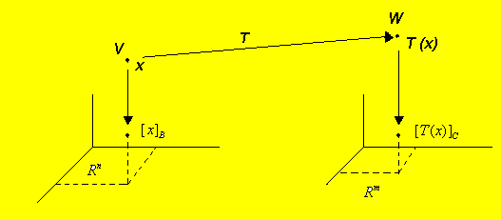

Slide 10
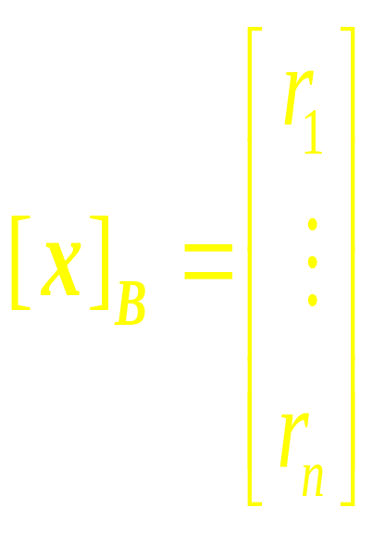
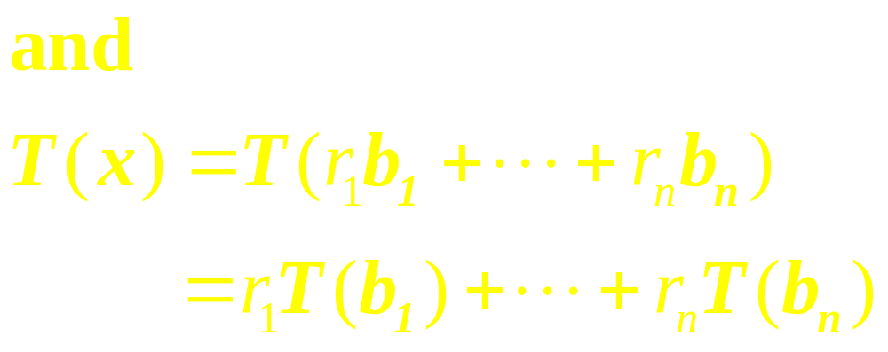
The Matrix of Linear
Transformation
Let {b₁ ,…,b_{n}} be the basis B for V.
If x = r₁b₁ +…+ r_{n}b_{n}, then
…

Slide 11
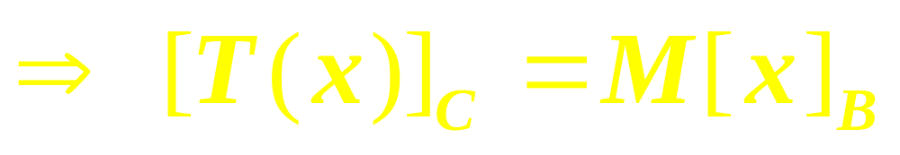
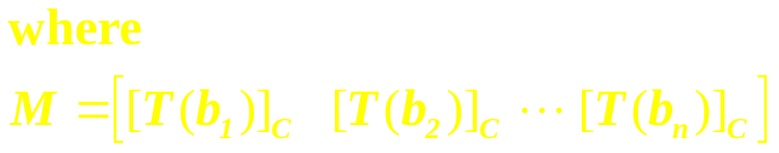
This equation can be written as

Slide 12
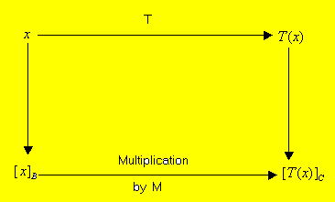
The Matrix M is the matrix representation of T, Called the matrix for T relative to the bases B and C

Slide 13

Example 1
Suppose that B = {b₁, b₂} is a basis for V and C = {c₁, c₂, c₃} is a basis for W. Let T: V W be a linear transformation with the property that
Find the matrix M for T relative to B and C.

Slide 14
LT from V into V
When W is the same as V and the basis C is the same as B, the matrix M is called the matrix for T relative to B or simply the B-matrix
….

Slide 15
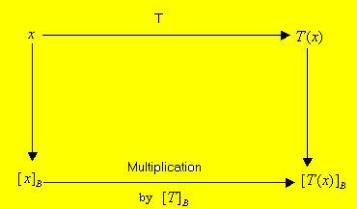

The B-matrix of T: V V satisfies

Slide 16
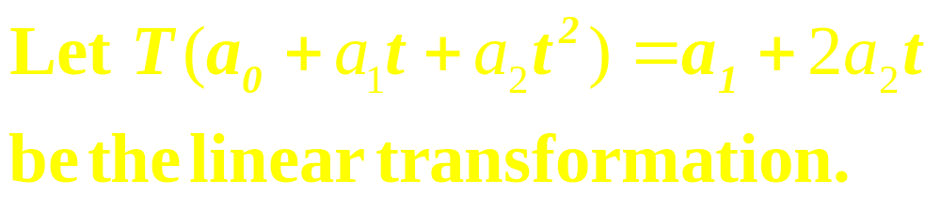
Example 2
(a) Find the B-matrix for T, when B is the basis {1, t, t²}.
(b) Verify that
[T(p)]_{B} = [T ]_{B}[p]_{B} for each p inP₂.

Slide 17
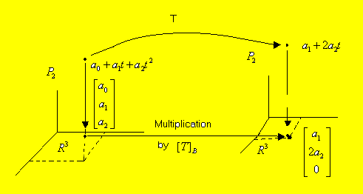

Slide 18
Linear
transformation
in
R^{n}

Slide 19
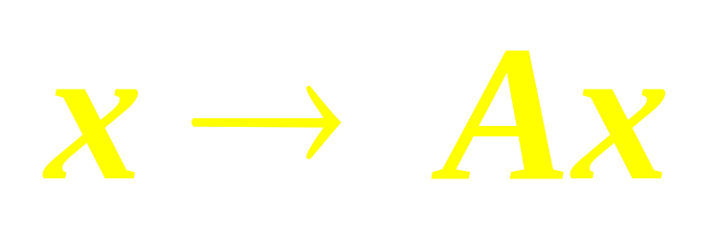
Theorem
Suppose A = PDP ⁻¹, where D is diagonal n x n matrix. If B is the basis for R^{n} formed from the columns of P, then D is the B-matrix of the transformation

Slide 20
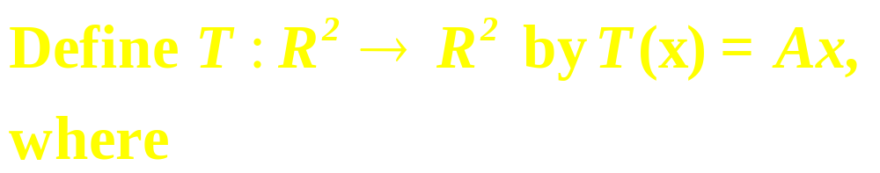
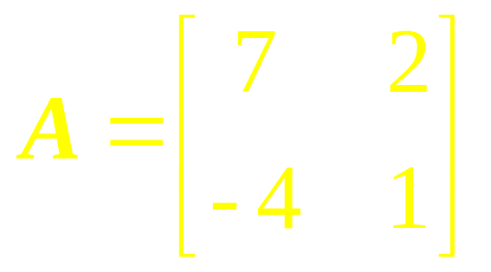
Example 3
Find a basis B for R² with the
property that the B-matrix of T
is a diagonal matrix.

Slide 21
Similarity of Matrix
Representations

Slide 22
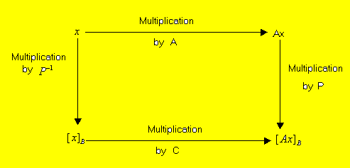
Similarity of two matrix
representations: A=PCP⁻¹

Slide 23
Examples

Slide 24
Matrix of Linear
Transformation

Slide 25
Similarity of Matrix
Representations

Slide 26
Linear Algebra
Lecture 31

